Slide 1




ASSOCIATION RULES MARKET BASKET ANALYSIS

Slide 2
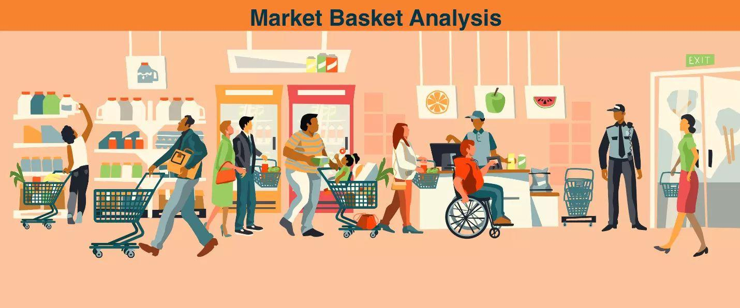

Slide 3
Introduction to Market Basket Analysis
Def: Market Basket Analysis (Association Analysis) is a mathematical modeling technique based upon the theory that if you buy a certain group of items, you are likely to buy another group of items.
It is used to analyze the customer purchasing behavior and helps in increasing the sales and maintain inventory by focusing on the point of sale transaction data.

Slide 4
Using Market Basket Analysis
The analysis can be applied in various ways:
Develop combo offers based on products sold together
Organize and place associated products/categories nearby inside a store
Determine the layout of the catalog of an ecommerce site
Control inventory based on product demands and what products sell together

Slide 5
Market basket analysis is a data mining technique used by retailers to increase sales by better understanding customer purchasing patterns.
It involves analyzing large data sets, such as purchase history, to reveal product groupings, as well as products that are likely to be purchased together.

Slide 6
Amazon is a great example that leverages this analysis to cross-sell products.
These are the products that come under the suggested item list which might interest you along with your current purchase.
Your browsing history, what other customers have bought with a given product, and other factors determine which products appear in the suggested category.

Slide 7
MBA
Basket-Set of item (whether you go to supermarket or buy online products)
Every basket has transaction ID. Not at Customer level (Data has transaction IDs and the list of Items Purchased, and not the amount of transaction)
Customers may have multiple transactions data and they are not really clubbed for customers. (Customer analytics requires data at customer level but MBA requires the data at Transaction level. So, Focus of MBA is on the items and not on the customers.)
Data has Transaction ID and List of Items.

Slide 8
Contents
Understanding Association Rules
Introduction to Market Basket Analysis
Uses
Definitions and Terminology
Rule Evaluation
Support
Confidence
Lift
Market Basket Analysis in R
Visualize & Plot Item Frequency
Get & Display the Rules

Slide 9
Rules…
Support
Confidence
Lift

Slide 10
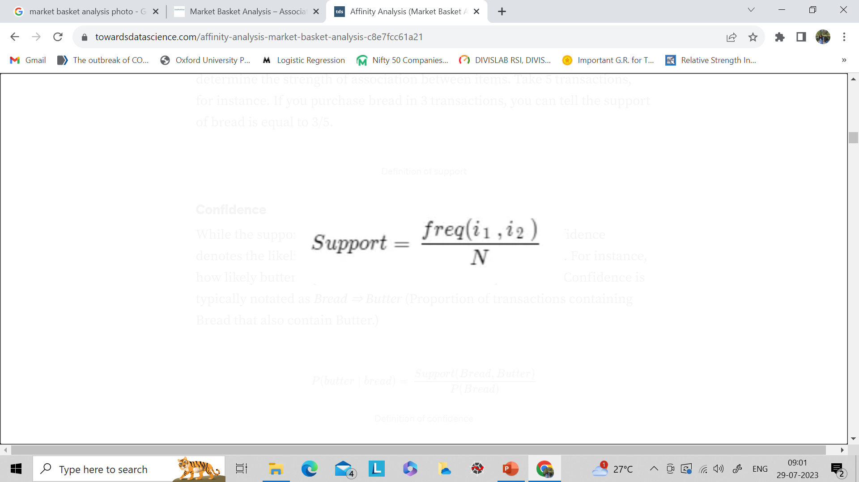
Support
Support simply emphasizes how popular an itemset is. Support, despite being simple, is an important metric in the Affinity Analysis that is used to determine the strength of association between items.
Take 5 transactions, for instance. If you purchase bread in 3 transactions, you can tell the support of bread is equal to 3/5.

Slide 11
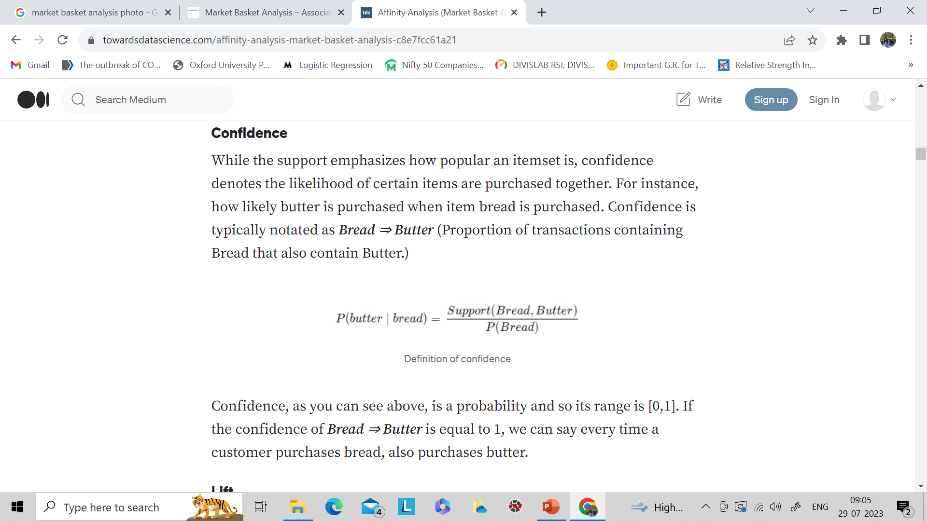
Confidence
While the support emphasizes how popular an itemset is, confidence denotes the likelihood of certain items are purchased together.
For instance, how likely butter is purchased when item bread is purchased.
Confidence is typically notated as Bread ⇒ Butter (Proportion of transactions containing Bread that also contain Butter.)

Slide 12
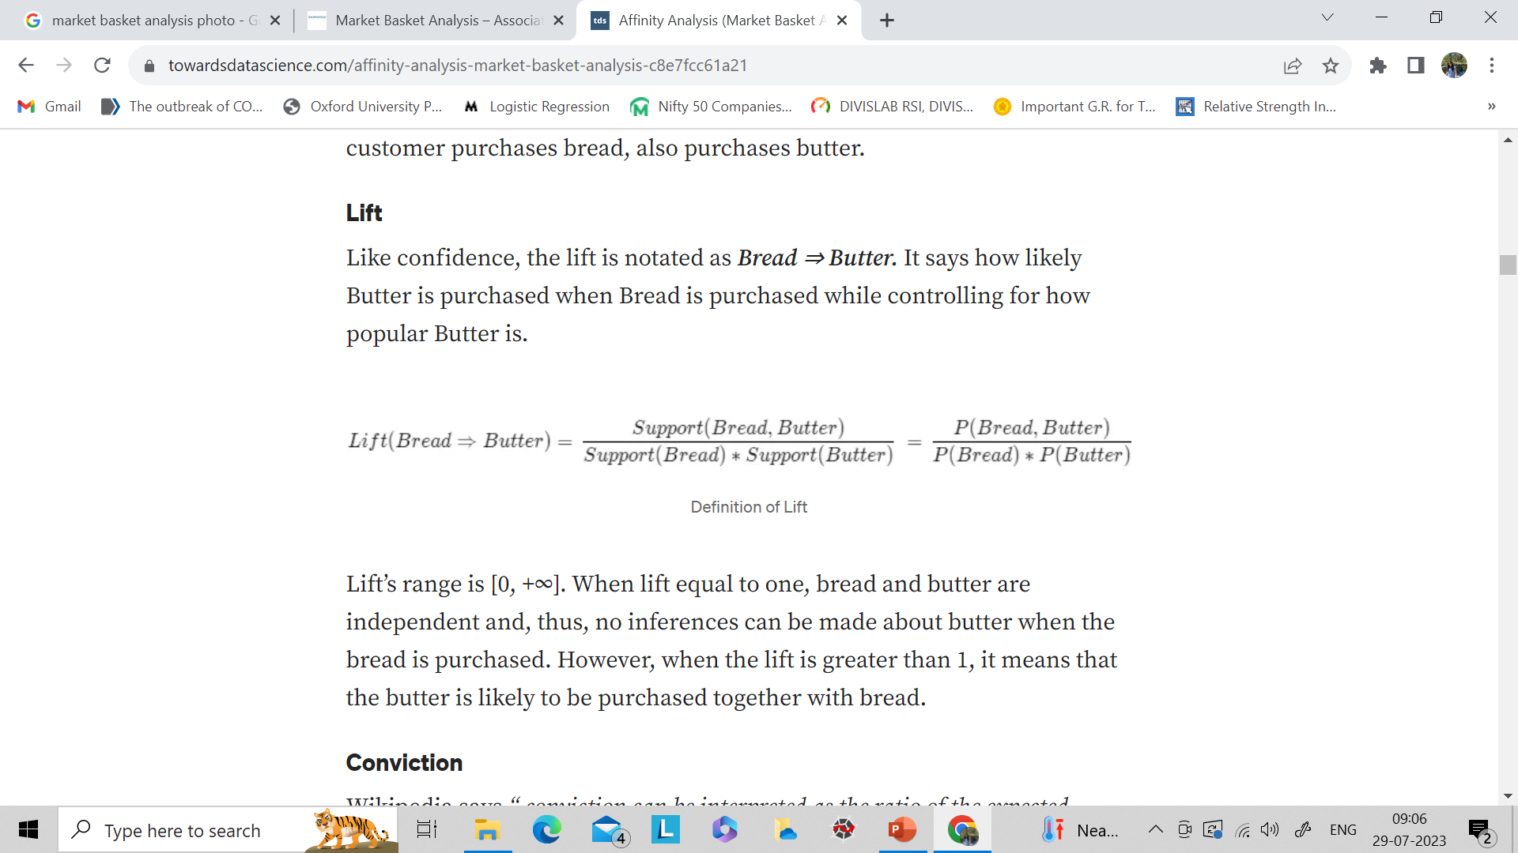
Lift

Slide 13
About Association Rules
Association Rule Learning
Method for discovering interesting relations between variables in large databases
Based on the concept of strong rules, Rakesh Agrawal introduced association rules concept.
Association rules are a popular technique in data mining and machine learning used to find interesting relationships (associations) between variables in large datasets. These rules are often used in market basket analysis to identify products that frequently co-occur in transactions.

Slide 14
Introduction to Market Basket Analysis
The most widely used area of application for association rules is Market Basket Analysis
It is used to analyze the customer purchasing behavior and helps in increasing the sales and maintain inventory by focusing on the point of sale transaction data
Market Basket Analysis (Association Analysis) is a mathematical modeling technique based upon the theory that if you buy a certain group of items, you are likely to buy another group of items

Slide 15
Market Basket Analysis – Uses
Product Building
Develop combo offers based on products bought together
Optimisation
Organise and place associated products/categories nearby inside a store
Advertising and Marketing
Determine the layout of the catalog of an ecommerce site
Inventory Management
Control inventory based on product demands and what products sell together

Slide 16
Definitions and Terminology
Term | Definition
Transactions | A set of items (Item set)
Support | Ratio of number of times two or more items occur together to the total number of transactions Support can be thought of as P(A and B)
Confidence | Conditional probability that a randomly selected transaction will include Item B given Item A P(B|A) (written as A => B)
Lift | Ratio of the probability of Items A and B occurring together (Joint probability) to the product of P(A) and P(B)

Slide 17
Get an Edge!
The Famous Story
An article in The Financial Times of London (Feb. 7, 1996) stated,
"The example of what data mining can achieve is the case of a large US supermarket chain which discovered a strong association for many customers between a brand of babies nappies (diapers) and a brand of beer. Most customers who bought the nappies also bought the beer. The best hypothesisers in the world would find it difficult to propose this combination but data mining showed it existed, and the retail outlet was able to exploit it by moving the products closer together on the shelves."

Slide 18
Rule Evaluation – Support
Transaction No. | Item 1 | Item 2 | Item 3 | …
100 | Beer | Diaper | Chocolate
101 | Milk | Chocolate | Shampoo
102 | Beer | Wine | Vodka
103 | Beer | Cheese | Diaper
104 | Ice Cream | Diaper | Beer
A B
Support of {Diaper, Beer}
Support of {Diaper, Beer} is 3/5

Slide 19
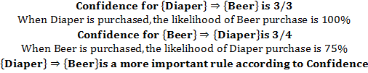
Rule Evaluation – Confidence
Transaction No. | Item 1 | Item 2 | Item 3 | …
100 | Beer | Diaper | Chocolate
101 | Milk | Chocolate | Shampoo
102 | Beer | Wine | Vodka
103 | Beer | Cheese | Diaper
104 | Ice Cream | Diaper | Beer

Slide 20

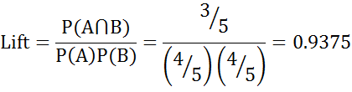
Rule Evaluation – Lift
Transaction No. | Item 1 | Item 2 | Item 3 | Item 4
100 | Beer | Diaper | Chocolate
101 | Milk | Chocolate | Shampoo
102 | Beer | Milk | Vodka | Chocolate
103 | Beer | Milk | Diaper | Chocolate
104 | Milk | Diaper | Beer
A B
Lift < 1 indicates Chocolate is decreasing the chance of Milk purchase
Support and confidence are high but lift is low

Slide 21
Case Study – Groceries Purchase Data
Background
Objective
Available Information
A typical grocery outlet records point-of-sale transaction data
To mine association rules and information about item sets
Data is collected for 1 month (30-days)
Total number of transactions is 9835
Items are aggregated to 169 categories

Slide 22
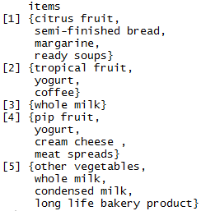
Data Snapshot
Groceries
Columns | Description | Possible values
id | Transaction Id | Positive Integers
items | Set of Items purchased in a transaction | Subset from 169 categories of items

Slide 23
Market Basket Analysis in R
#Market Basket Analysis Using Apriori Recommendation
install.packages("arules") library(arules) install.packages("arulesViz") library(arulesViz) data("Groceries")
We will be using two packages for performing
Market Basket Analysis in R.
Package “arules” stands for ‘Association Rules’
and it contains functions for mining association
rules and frequent itemsets.
Package “arulesViz” is used for visualisation.
Install and load these two packages.
Load the dataset.
The Groceries data set is provided for package arules by Michael
Hahsler, Kurt Hornik and Thomas Reutterer.*
The data is of class ‘transaction’ supported by package arules.

Slide 24
Visualise Item Frequency
#Item Frequency Plot
itemFrequencyPlot(Groceries,topN=10,type="absolute", main="Item Frequency")
itemFrequencyPlot() calculates item frequency and returns a
barplot.
topN= instructs R to plot only top N highest item frequency or lift
(Logical, if lift=TRUE). It plots values in decreasing order.
type= is a character string indicating whether item frequencies
should be displayed relative or absolute. Default is relative.

Slide 25
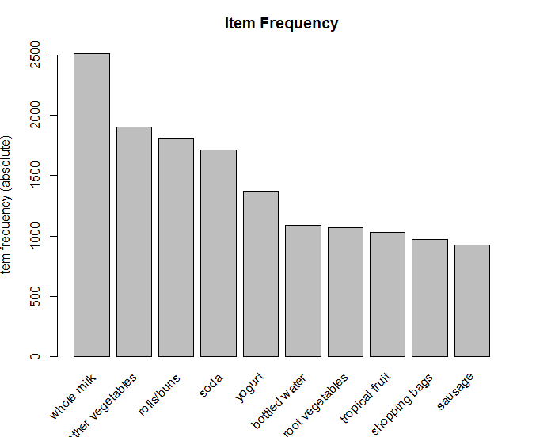
Item Frequency Plot
# Output
Interpretation:
The plot shows items by frequency
in a descending order.

Slide 26
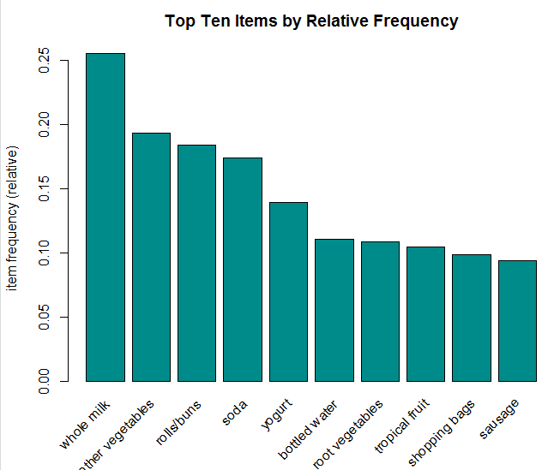
Item Frequency Plot
itemFrequencyPlot(Groceries,topN=10,type="relative", col="darkcyan",main="Top Ten Items by Relative Frequency")
type= “relative” displays barplot with the relative frequency
col= specifies the colour of the bars
# Output
Interpretation:
The plot shows items by relative frequency in a descending order.

Slide 27
Get and Display the Rules
#Get the Rules
rules<-apriori(Groceries,parameter=list(supp=0.001,conf=0.8))
The Apriori algorithm employs level-wise search for frequent
itemsets.
apriori() is used to mine frequent itemsets, association rules or
association hyperedges using this algorithm.
The default is to mine rules with support 0.1, confidence 0.8.
Here, we have used threshold of 0.001 for support.
apriori() returns an object of class rules or itemsets.
#Show Top 5 Rules But Only 2 Digits
options(digits=2) inspect(rules[1:5])
options in base R allows the user to set global options which affect the way in which R computes and displays results. We have set digits=2 to display results with only 2 digits.
inspect in package arules displays association and plus additional information formatted for online inspection.

Slide 28
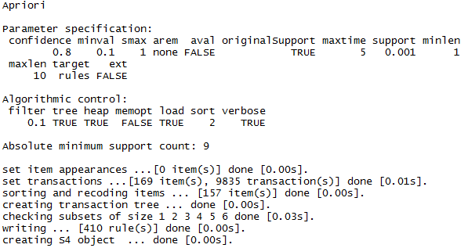
Get and Display the Rules
# Output of Rules
Interpretation:
The output displays parameter specification, algorithmic control and absolute minimum support count.
It also lists down tasks performed and time taken to complete them.
We are interested in knowing how many rules were created; 410 in our case.

Slide 29
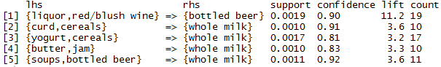
Get and Display the Rules
# Output of inspect
Interpretation:
inspect() returns list of lhs and rhs items, their support, confidence and lift values.
Notes:
VO: …

Slide 30
Manage How the Rules are Displayed
#Sort the Rules
rules<-sort(rules,by="lift",decreasing=TRUE)
sort() from package arules is used
by=“lift” indicates sort by values of Lift
decreasing= logical, specifies the direction of sorting. Default is
decreasing=TRUE.
#Show Top 5 Rules (Sorted)
options(digits=2) inspect(rules[1:5])

Slide 31
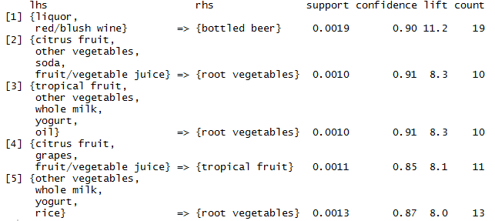
Top Five Rules (Sorted)
# Output
Interpretation:
The rules are now sorted based on lift. Sorting ensures that most relevant rules appear first.

Slide 32
Targeting Items
Association rules should be used to explain decision making and further utilised to form effective strategies.
Continuing with the example of consumer’s buying preferences, the following two questions can be of interest. Reference item is Whole Milk.
What are customers likely to buy if they purchase whole milk?

Slide 33
Targeting Items
library(arules) data("Groceries") rules<-apriori(Groceries,parameter=list(supp=0.001,conf= 0.15,minlen=2),appearance=list(default="rhs",lhs="whole milk"),control=list(verbose=FALSE)) rules<-sort(rules,decreasing=TRUE,by="confidence") inspect(rules[1:5])
We have already seen the basic arguments used in apriori().
minlen= in parameter= is used to specify how many items to be considered
Default is minlen=1 which means that rules with only one item will be created.
appearance= is used to restrict item appearance.
control= controls the algorithmic performance of mining algorithm.
verbose=FALSE ensures R does not show progress report.
*
Here we continue with previous ppt & use the same inbuilt dataset “Groceries”

Slide 34
supp=0.001: Minimum support threshold. Rules with a support less than 0.1% are excluded.
conf=0.15: Minimum confidence threshold. Rules with a confidence less than 15% are excluded.
minlen=2: Minimum length of the rules. This ensures that rules contain at least 2 items.
Appearance:
This specifies constraints on the items appearing in the rules.
default="rhs": By default, items are allowed only in the right-hand side (consequent) of the rules.
lhs="whole milk": Specifies that "whole milk" must appear in the left-hand side (antecedent) of the rules.
verbose=FALSE: Suppresses the printing of progress and summary messages during the rule mining process.

Slide 35
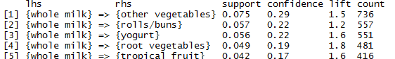
Targeting Items
# Output
Interpretation:
Based on confidence, customers are most likely to move to other vegetables immediately after buying whole milk.

Slide 36
Visualise Rules
#Creating Interactive Graph
library(arulesViz) rules<-apriori(Groceries,parameter=list(supp=0.001,conf=0.15,minlen=2), appearance=list(default="rhs",lhs="whole milk"),control=list(verbose=FALSE)) plot(rules,method="graph",interactive=TRUE,shading=NA)
plot() is the default function to visualise association rules and itemsets in
package arulesViz. If no argument is specified other than the object, then
the function returns a simple scatter plot.
The package offers different plot styles. method= tells R which style to
use for visualisation. Here, we are using "graph"
interactive= is a logical, specifying whether to return plot in interactive mode.
shading= is used to enhance the interpretability of the graph, by using colour
shading to represent measure of interest (Such as confidence, lift, etc.).
shading=NA tells R not to have any such component in the plot.

Slide 37
Interactive Graphs
Upon running the command for interactive graph in arulesViz, a new window opens
Graph uses vertices and edges to visualise rules
Vertices are itemsets or items
Edges indicate relationship in rules
Labels on the edges or colour or width of the arrows displaying edges represent interest measures
Note that graph-based visualisations are viable only for a small set of rules, as more number of rules would make the graph cluttered and difficult to interpret

Slide 38
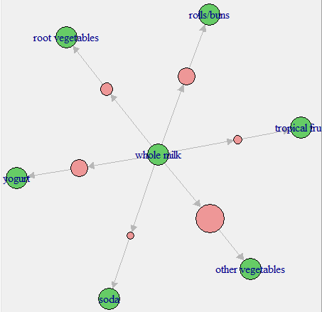
Interpreting the Interactive Graph
Out target item is whole milk, which is at the centre of the graph
The coloured vertex represent confidence. As seen before, confidence for {whole milk, other vegetables} is the highest, followed by yogurt and rolls/buns.
Lowest confidence in the top five is for {whole milk, tropical fruit}

Slide 39
Using MBA for Recommendations
Support can be used for initial recommendations or to determine the layout of the catalog of an ecommerce site
Confidence can be used to provide recommendations based on first product purchase.
Use rules only if lift is greater than one.

Slide 40
THANK YOU!!

